Slide 1
Dealing with multicollinearity
Angie
29/07/2019

Slide 2
What is multicollinearity?
Multicollinearity occurs when independent variables in a regression model are correlated.

Slide 3
What problems can this cause?
it can increase the variance of the coefficient estimates and make the estimates very sensitive to minor changes in the model.
lead to overfitting
higher standard error with lower statistical significance value
Notes:
It can reduce our overall coefficient as well as our p-value (known as the significance value) and cause unpredictable variance. This will lead to overfitting where the model may do great on known training set but will fail at unknown testing set. As this leads to higher standard error with lower statistical significance value, multicollinearity makes it difficult to ascertain how important a feature is to the target variable. And with a lower significance value, we will fail to reject the null, which leads to type II error for our hypothesis testing.

Slide 4
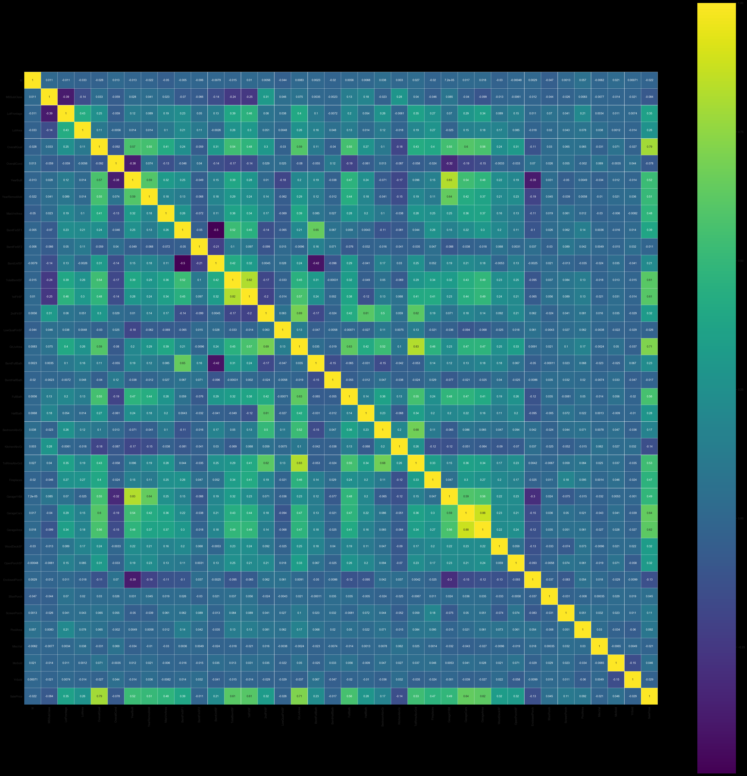
Back to Project 3…
Numerical (36)
House data
Categorical (43)
My method is by looking at the highly correlated variables to sale price, and check whether they have multicollinearity with other variables, and drop the weaker predictor of SalePrice variables

Slide 5
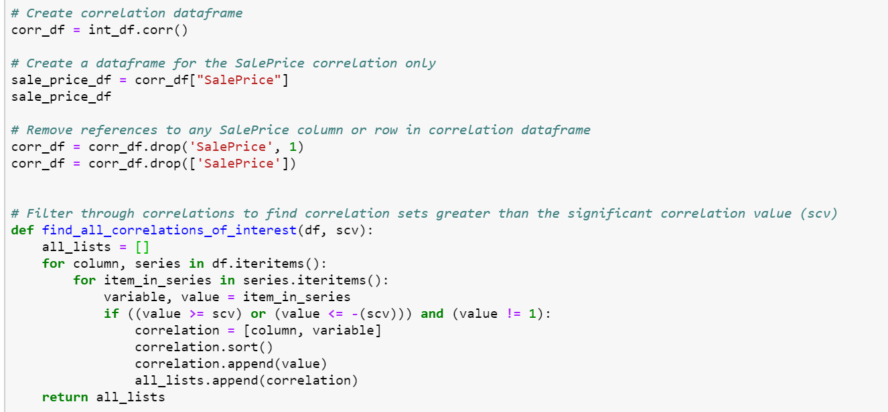
Moderate multicollinearity may not be problematic. However, severe multicollinearity is a problem
My method is by looking at the highly correlated variables to sale price, and check whether they have multicollinearity with other variables, and drop the weaker predictor of SalePrice variables

Slide 6
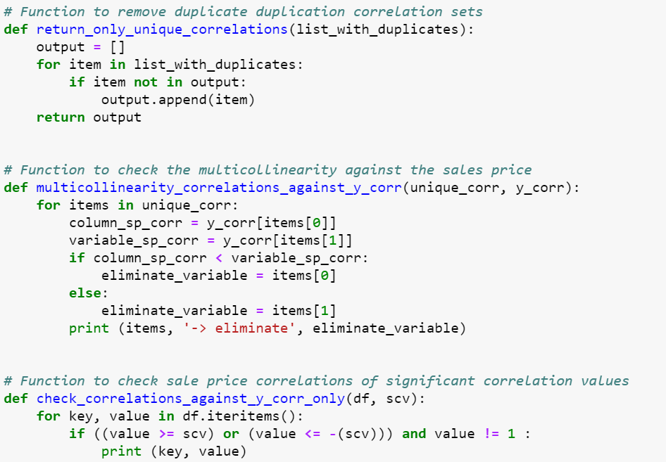
My method is by looking at the highly correlated variables to sale price, and check whether they have multicollinearity with other variables, and drop the weaker predictor of SalePrice variables

Slide 7
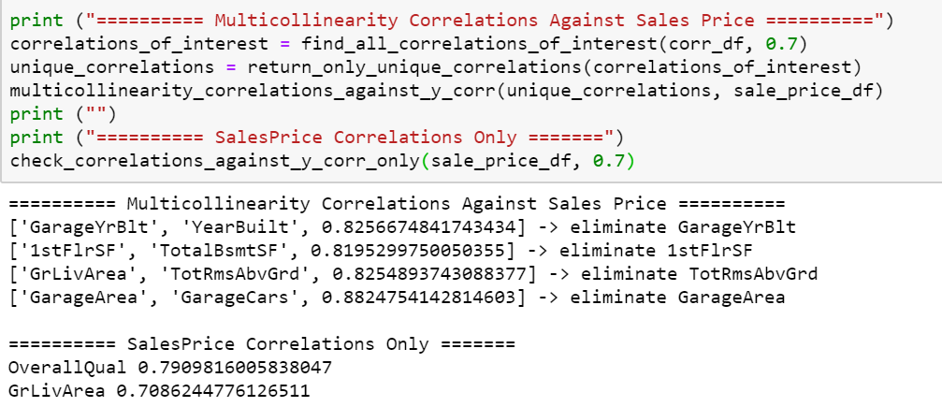
My method is by looking at the highly correlated variables to sale price, and check whether they have multicollinearity with other variables, and drop the weaker predictor of SalePrice variables

